Slide 1
Shri vaisnav vidhyapeeth viswavidhalaya “Recommend new motion pictures, songs and documentaries to users”
Submitted to- Mr Gaurav Thulla submitted by- Akshata anil Shukla
18100BTCSAII02829
B.TECH(spec. in AI)
II nd year

Slide 2
INTRODUCTION
Have you ever been on an online streaming platform like Netflix, Amazon Prime, Voot ? I watched a movie and after some time, that platform started recommending me different movies and TV shows. I wondered, how the movie streaming platform could suggest me content that appealed to me. Then I came across something known as Recommendation System. This system is capable of learning my watching patterns and providing me with relevant suggestions. Having witnessed the fourth industrial revolution where Artificial Intelligence and other technologies are dominating the market, I am sure that you must have come across a recommendation system in your everyday life.

Slide 3
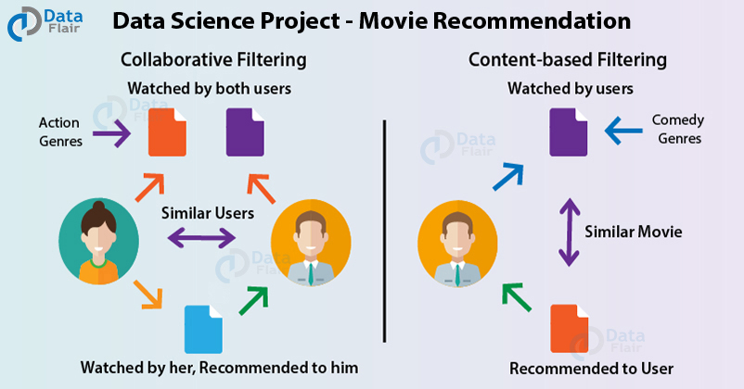

Slide 4
Movie Recommendation System Project using Machine Learning
The main goal of this machine learning project is to build a recommendation engine that recommends movies to users. This R project is designed to help us understand the functioning of how a recommendation system works. We will be developing an Item Based Collaborative Filter.
In this project, “supervised algorithm” is applied in movie recommendation system.

Slide 5
What is a Recommendation System?
A recommendation system provides suggestions to the users through a filtering process that is based on user preferences and browsing history. The information about the user is taken as an input. The information is taken from the input that is in the form of browsing data. This information reflects the prior usage of the product as well as the assigned ratings. A recommendation system is a platform that provides its users with various contents based on their preferences and likings. A recommendation system takes the information about the user as an input. The recommendation system is an implementation of the machine learning algorithms.
Another important role that a recommendation system plays today is to search for similarity between different products. In the case of Netflix, the recommendation system searches for movies that are similar to the ones you have watched or have liked previously. This is an important method for scenarios that involve cold start. In cold start, the company does not have much of the user data available to generate recommendations. Therefore, based on the movies that are watched, Netflix provides recommendations of the films that share a degree of similarity.

Slide 6
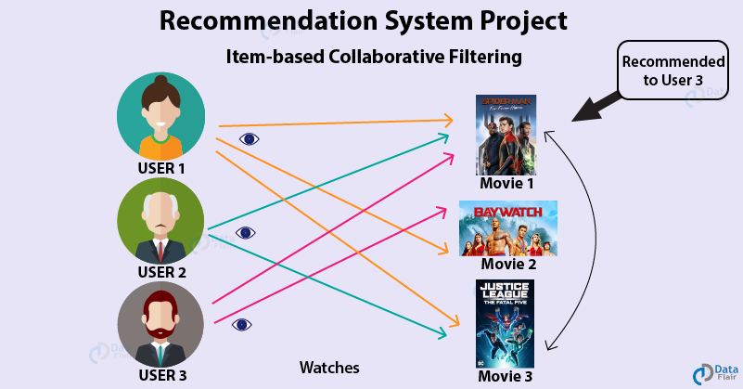

Slide 7
A recommendation system also finds a similarity between the different products. For example, Netflix Recommendation System provides you with the recommendations of the movies that are similar to the ones that have been watched in the past. Furthermore, there is a collaborative content filtering that provides you with the recommendations in respect with the other users who might have a similar viewing history or preferences. There are two types of recommendation systems – Content-Based Recommendation System and Collaborative Filtering Recommendation. In this project of recommendation system in R, we will work on a collaborative filtering recommendation system and more specifically, ITEM based collaborative recommendation system.

Slide 8
Types of recommendation system
1. Content-based recommendation systems
In a content-based recommendation system, the background knowledge of the products and customer information are taken into consideration. Based on the content that you have viewed on Netflix, it provides you with similar suggestions.
For example, if you have watched a film that has a sci-fi genre, the content-based recommendation system will provide you with suggestions for similar films that have the same genre.
2. Collaborative filtering recommendation systems
Unlike the content based filtering that provided recommendations of similar products, Collaborative Filtering provides recommendations based on the similar profiles of its users. One key advantage of collaborative filtering is that it is independent of the product knowledge. Rather, it relies on the users with a basic assumption that what the users liked in the past will also like in the future.
For example, if a person A watches crime, sci-fi and thriller genres and B watches sci-fi, thriller and action genres then A will also like action and B will like crime genre.

Slide 9
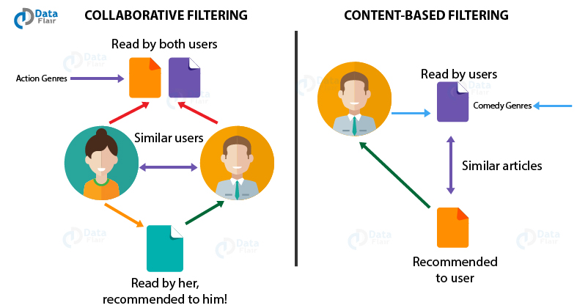

Slide 10

Video Representation -

Slide 11
Thank you for listening to me carefully!!!

